Slide 1
Day 04
Linux Device Driver Training
Using Commands
Presented by,
Ganavi M
Ganavigowda512@gmail.com

Slide 2
CHANGING PERMISSIONS
Command: chmod
Syntax: chmod [ugoa][+/-][rwx] FILENAME
Explanation:
Specifies the new permissions to be set for the file or directory, represented as a numeric mode or symbolic mode.
Specifies the file or directory whose permissions are to be changed.
Options:
-R or --recursive: Changes permissions recursively, including all files and subdirectories within a directory.
Permission Modes:
Numeric Mode: Uses a three-digit octal number to represent permissions for user, group, and others (e.g., 644 for rw-r--r--).
Symbolic Mode: Uses symbols (+, -, =) to add, remove, or set permissions explicitly (e.g., u+rwx, g-w, o=r).
Example:
chmod 644 file.txt: Sets the permissions of "file.txt" to rw-r--r-- (read and write for the owner, read-only for the group and others).
chmod +x script.sh: Adds executable permission to "script.sh" for the owner, group, and others.

Slide 3
CHANGING OWNERSHIP
Command: chown
Syntax: chown [OPTIONS] USER[:GROUP] FILE
Explanation:
USER: Specifies the new owner of the file or directory.
GROUP: (Optional) Specifies the new group ownership of the file or directory. If omitted, the group ownership remains unchanged.
FILE: Specifies the file or directory whose ownership is to be changed.
Options:
-R or --recursive: Changes ownership recursively, including all files and subdirectories within a directory.
when we use chmod 777, we're giving the maximum permissions:
Owner: Read (4) + Write (2) + Execute (1) = 7
Group: Read (4) + Write (2) + Execute (1) = 7
Others: Read (4) + Write (2) + Execute (1) = 7
This means that the file can be read from, written to, and executed by anyone on the system. While this provides maximum flexibility, it also poses significant security risks, as anyone can modify or execute the file.

Slide 4
COMMANDS
ls: List directory contents. Example: ls -l (lists in long format)
ls –lt : to check the permission of the file.
cd: Change directory. Example: cd Documents (moves to the Documents directory)
pwd: Print working directory. Example: pwd (displays the current directory)
mkdir: Make directory. Example: mkdir new_directory (creates a new directory named "new_directory")
rm: Remove files or directories. Example: rm file.txt (deletes file.txt)
rmdir: Remove empty directories. Example: rmdir empty_directory (deletes the empty directory "empty_directory")
cp: Copy files or directories. Example: cp file.txt new_location (copies file.txt to new_location)
mv: Move (rename) files or directories. Example: mv file.txt new_name.txt (renames file.txt to new_name.txt)
cat: Concatenate and display files. Example: cat file.txt (displays the contents of file.txt)
FOR HELP: ls - -help

Slide 5
head:
head is used to display the first few lines of a file.
By default, it displays the first 10 lines of a file.
Example: head file.txt (displays the first 10 lines of "file.txt").
You can specify the number of lines using the -n option, e.g., head -n 5 file.txt to display the first 5 lines.
tail:
tail is used to display the last few lines of a file.
By default, it displays the last 10 lines of a file.
Example: tail file.txt (displays the last 10 lines of "file.txt").
You can specify the number of lines using the -n option, e.g., tail -n 5 file.txt to display the last 5 lines.
more:
more is used to display the contents of a file one screen at a time.
After displaying each screen, it waits for user input (typically pressing the spacebar) to display the next screen.
Example: more file.txt (displays the contents of "file.txt" one screen at a time).
It does not allow scrolling back to previous screens.
less
less is similar to more but provides more features, including backward scrolling.
It allows scrolling both forward and backward through the file.
Example: less file.txt (displays the contents of "file.txt" with advanced scrolling features).
Press the arrow keys or Page Up/Page Down keys to navigate through the file.

Slide 6
wc (Word Count):
wc command is used to count the number of lines, words, and characters in a file or standard input.
Syntax: wc [OPTIONS] [FILES]
Common options:
-l: Count lines.
-w: Count words.
-c: Count characters.
Example: wc -l file.txt (count the number of lines in "file.txt").
grep:
grep stands for "global regular expression print".
It is used to search for text patterns within files or input streams.
Syntax: grep [OPTIONS] PATTERN [FILES]
Common options:
-i: Ignore case.
-r: Recursively search directories.
-v: Invert match (display lines that do not match).
Example: grep "pattern" file.txt (search for "pattern" in "file.txt").

Slide 7
DIFFERENCE BETWEEN cp AND mv COMMAND
mv (Move) Command:
The mv command is used to move files or directories from one location to another.
When you use mv, the file or directory is physically moved from its current location to the new location.
After moving, the original file or directory is no longer present in its original location.
Example:
mv file.txt /path/to/new/location/
cp (Copy) Command:
The cp command is used to copy files or directories from one location to another.
When you use cp, a duplicate of the file or directory is created in the new location, leaving the original file or directory intact.
This means that both the original and copied files or directories exist independently of each other.
Example:
cp file.txt /path/to/new/location/

Slide 8
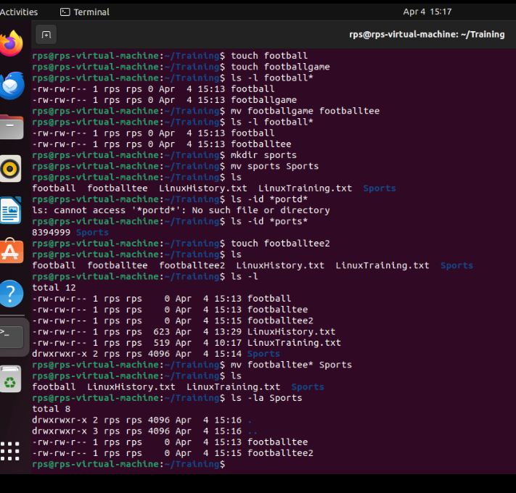
MOVE COMMAND

Slide 9
NANO COMMAND
Open a File:
Syntax : nano filename.txt
Replace filename.txt with the name of the file you want to edit or create. If the file exists, Nano will open it. If not, Nano will create a new file with the specified name.
Write/Edit Text:
Use the arrow keys to navigate to the location where you want to write or edit text.
Type the text you want to add or modify.
Save Changes:
To save changes, press Ctrl + O (Hold the Ctrl key and then press O).
Nano will prompt you to confirm the filename. Press Enter to save changes to the same file or type a new filename to save changes to a different file.
Exit Nano:
After saving the changes, you can exit Nano by pressing Ctrl + X (Hold the Ctrl key and then press X).
If you have unsaved changes, Nano will prompt you to save them before exiting. Press Y to save changes, or N to discard changes

Slide 10
WILDCARDS
Period (.):
In the command-line interface, the period (.) typically represents the current directory.
When used in file paths or directory paths, the period (.) refers to the current working directory.
For example, if you're in the directory /home/user, then ./file.txt refers to the file file.txt in the current directory.
Similarly, ./subdir/ refers to the subdirectory subdir in the current directory.
Question Mark (?):
In shell scripting, the question mark (?) is a wildcard character that represents any single character.
It can be used in filename patterns or regular expressions to match any single character at that position.
For example, if you have files named file1.txt, file2.txt, and file3.txt, then file?.txt would match any of these files.
Similarly, ?.txt would match any single character followed by .txt, such as a.txt, b.txt, etc.

Slide 11
The command chmod -R 777 / makes every single file on the system under / (root) have rwxrwxrwx permissions. This is equivalent to allowing ALL users read/write/execute permissions
How can you see all the files in a directory, including hidden ones? ls-a
How can you search for files based on their creation date?
find ~/Documents -type f -ctime –7
What are some basic text editing commands you can use in the terminal?
nano, gedit, vim
The "file" command tells us what type of file it might be text, executable, PDF, jpg, gzip, tar, directory, etc.
$ file read-write.txt

Slide 12
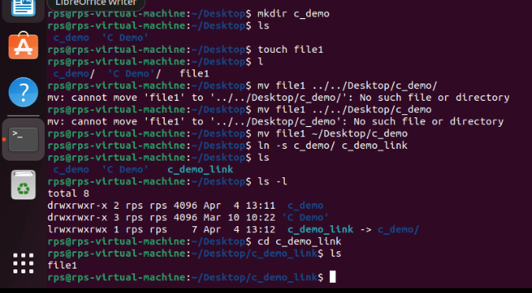
CREATING THE SHORTCUT LINK

Slide 13
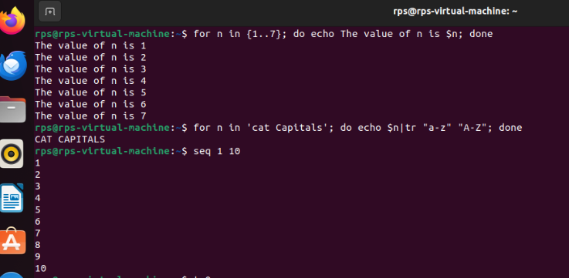
SHELL SCRIPTING
Shell scripting is the practice of writing scripts or programs to automate tasks, perform system administration, and execute commands within a command-line interpreter such as Bash or Zsh.

Slide 14
Thank you

